Slide 2
Essential Question:
What were the important causes & effects of the French Revolution?
Warm-Up Question:
Is there a situation you can think of where you would try and overthrow your own government?

Slide 3
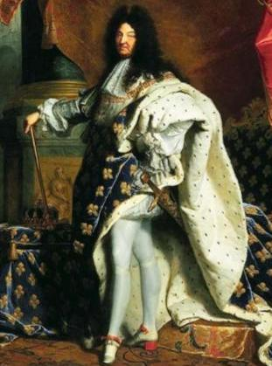
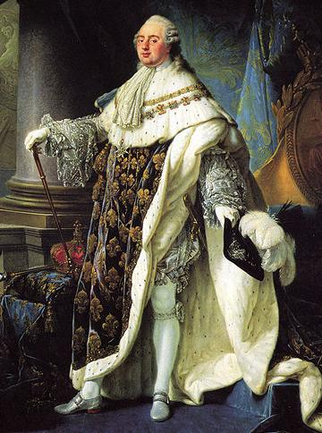
Reasons for the French Revolution
In the 1700s, France was the cultural capital of Europe, home to numerous Enlightenment thinkers, & had wealth from colonies
King Louis XIV was the most powerful king in Europe; After his death in 1715, Louis XV & Louis XVI continued to rule France as absolute monarchs
But, political & economic problems led to the French Revolution in 1789
King Louis XIV
King Louis XVI
Notes:
BOURBON DYNASTY
HENRY IV of France, 1553-1610, king of France (1589-1610) Edict of Nantes 1598 LOUIS XIII, 1601-1643, king of France (1610 - 1643), son of Henry IV LOUIS XIV, 1638–1715, king of France (1643–1715), son of Louis XIII, personal rule after 1661 LOUIS XV, 1710–74, king of France (1715–74), great-grandson of King Louis XIV LOUIS XVI, 1754–93, king of France (1774–92), third son of the dauphin (Louis) and Marie Josèphe of Saxony, grandson and successor of King Louis XV. Executed in 1792.

Slide 4
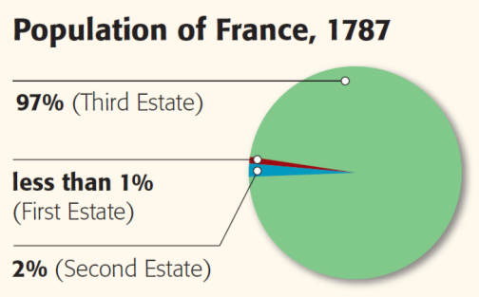
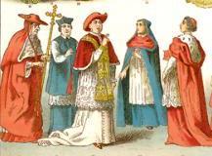
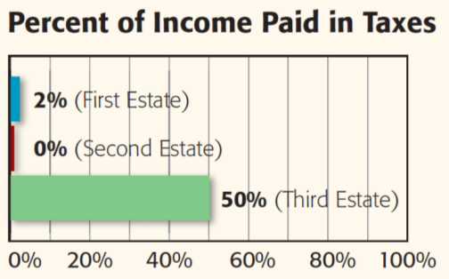
One problem was France’s unequal social hierarchy that was made up of three classes (called estates)
The clergy of the Roman Catholic Church made up the First Estate
Owned 10% of land in France but paid little in taxes to the gov’t

Slide 5
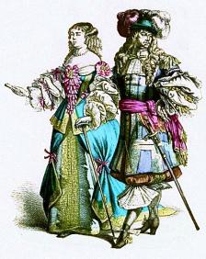
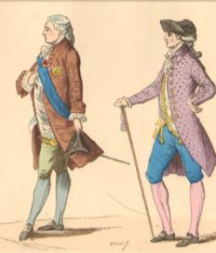
One problem was France’s unequal social hierarchy that was made up of three classes (called estates)
The Second Estate was made up of rich nobles
Owned 20% of French land but were exempt from paying taxes

Slide 6
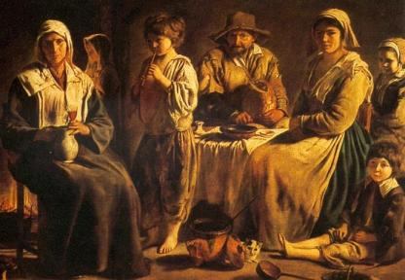
One problem was France’s unequal social hierarchy that was made up of three classes (called estates)
The Third Estate made up 97% of the population & included poor peasants but also the well-educated middle class (bourgeoisie)
This group paid 50% of their income in taxes

Slide 7
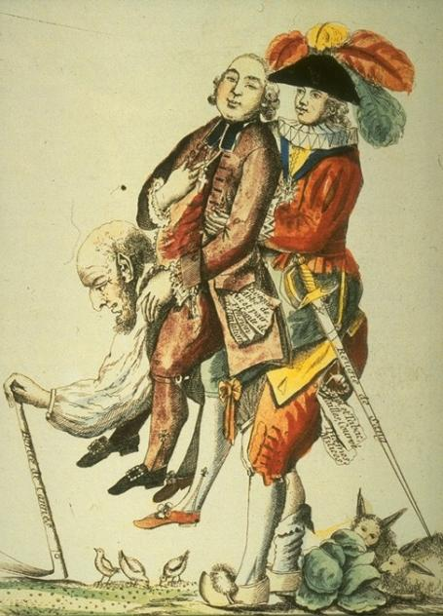
The members of the Third Estate resented the special treatment the First & Second Estates received
Members of the Third Estate gained inspiration from the Enlightenment ideas of John Locke, Voltaire, & Rousseau
After the success of the American Revolution, the Third Estate began demanding democracy, equality, & liberty in France
Notes:
BOURBON DYNASTY
HENRY IV of France, 1553-1610, king of France (1589-1610) Edict of Nantes 1598 LOUIS XIII, 1601-1643, king of France (1610 - 1643), son of Henry IV LOUIS XIV, 1638–1715, king of France (1643–1715), son of Louis XIII, personal rule after 1661 LOUIS XV, 1710–74, king of France (1715–74), great-grandson of King Louis XIV LOUIS XVI, 1754–93, king of France (1774–92), third son of the dauphin (Louis) and Marie Josèphe of Saxony, grandson and successor of King Louis XV. Executed in 1792.

Slide 8
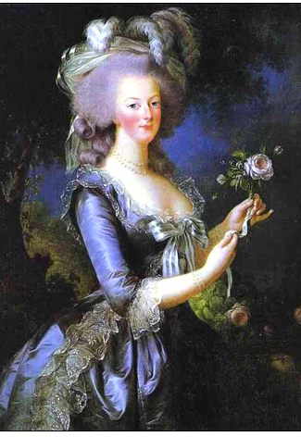
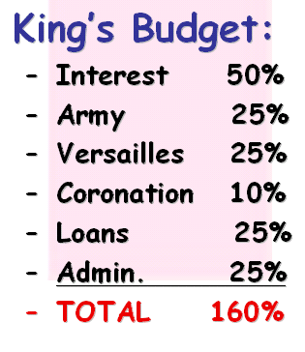
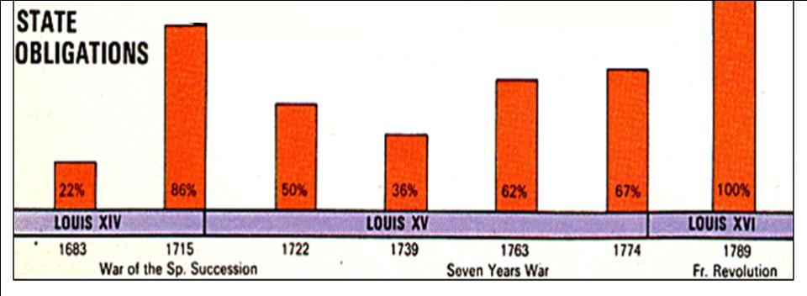
Social tensions were made worse by a growing financial crisis in the 1770s & 1780s
The French government faced massive debts due to decades of lavish spending, expensive wars, & poor economic planning
GOVERNMENT DEBTS
(percentage of total government revenue)
By 1789, half the budget went towards interest on the national debt; 25% of people were unemployed
The excessive spending by King Louis XVI & his wife Marie Antoinette angered French citizens
Marie Antoinette, “Madame Deficit”

Slide 9
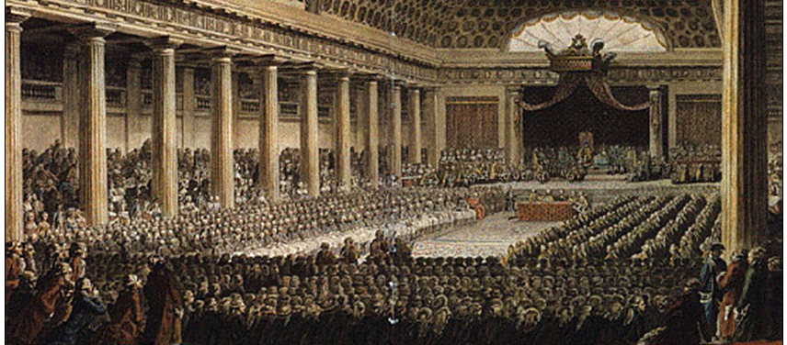
Role Play Class Activity:
From your role card perspective, develop a plan that could save France, decide to vote by order or by head, & present your ideas to the king
By 1789, France was out of money & faced a serious financial crisis
Louis XVI called an emergency meeting of the Estates-General where members from all 3 classes could advise the king

Slide 10
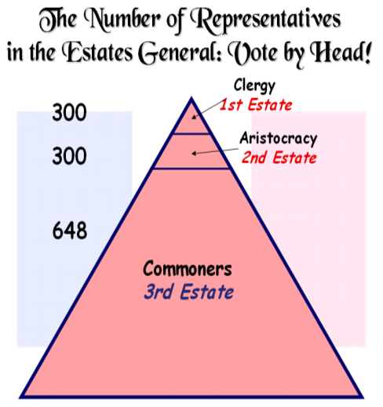
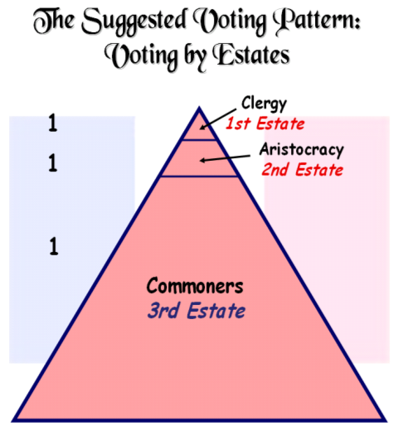
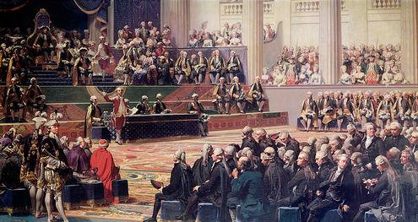
During the Estates-General, the First & Second Estates voted to increase taxes on the Third Estate
The First & Second Estates decided to vote by order (1 vote per estate) rather than by head (by person)
These decisions angered the members of the Third Estate who believed their rights were being violated

Slide 11
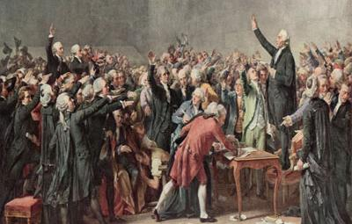
The Third Estate formed a new National Assembly to make laws for the French people
In 1789, the National Assembly swore to a Tennis Court Oath promising a new constitution & limitations on the king’s power

Slide 12
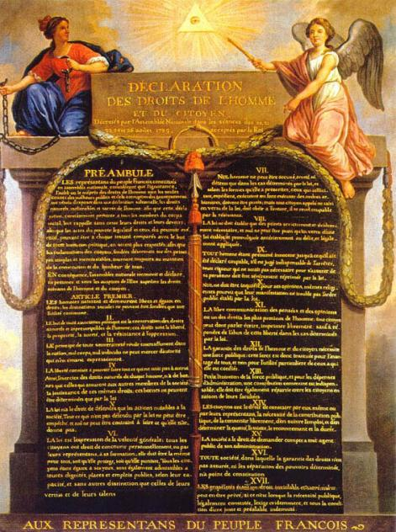
The National Assembly wrote their revolutionary ideals in the Declaration of the Rights of Man and of the Citizen which said:
“Men are born free and equal in rights”
Rights include “liberty, property, security, & resistance to oppression”
It guaranteed freedom of speech, &freedom of religion, & equal justice

Slide 13
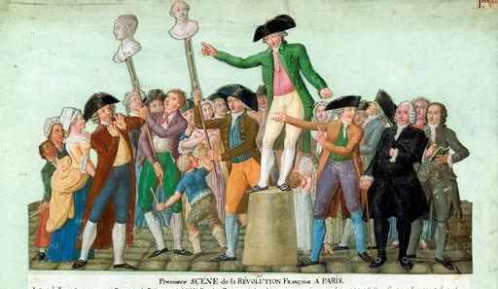
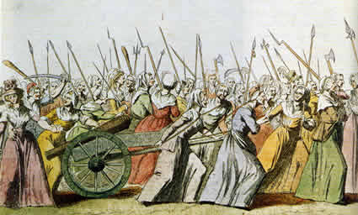
Meanwhile, the economic crisis continued
Citizens were without food & faced starvation
Angry protestors in Paris demanded new reforms

Slide 14
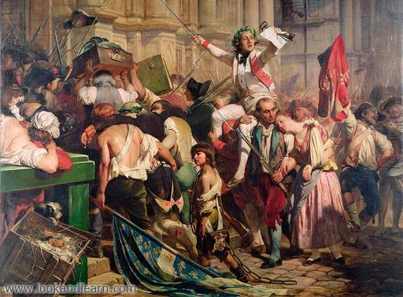
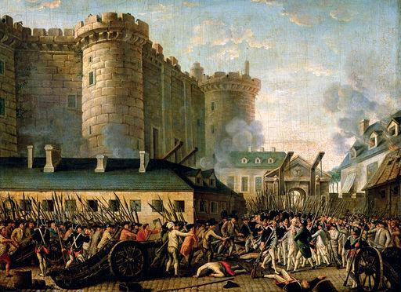
When rumors circulated that the king was going to send his army to Paris, citizens attacked the prison Bastille to seize weapons to defend themselves
The storming of the Bastille in 1789 represented the beginning of the French Revolution

Slide 15
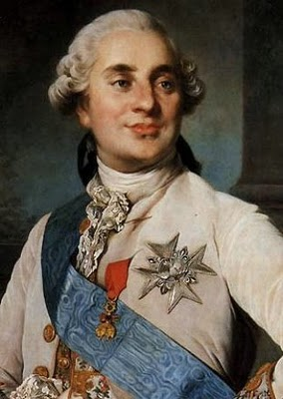
In 1791, Louis XVI finally agreed to a new constitution that limited his power & created a limited monarchy
But, Louis XVI failed to work with the National Assembly & France’ problems continued
Fearing the spread of France’s revolutionary ideas, Austria & Prussia assembled armies to restore France’s absolute monarchy
Quick Class Discussion:
What should the National Assembly do to solve France’s problems?

Slide 16
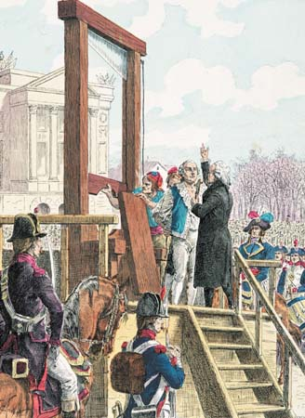
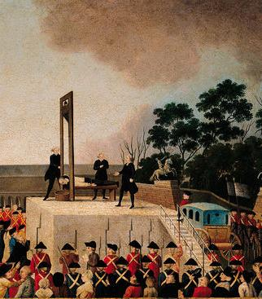
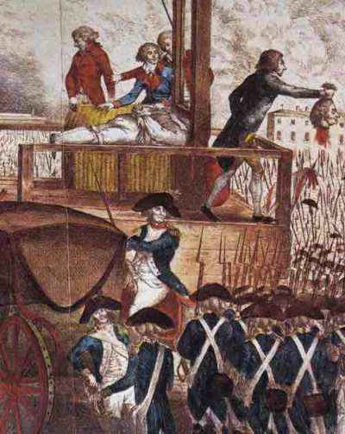
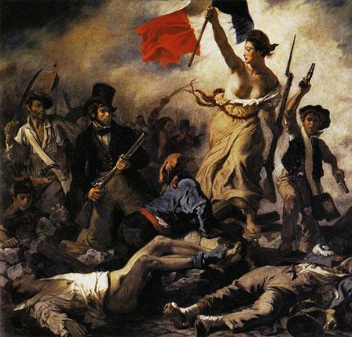
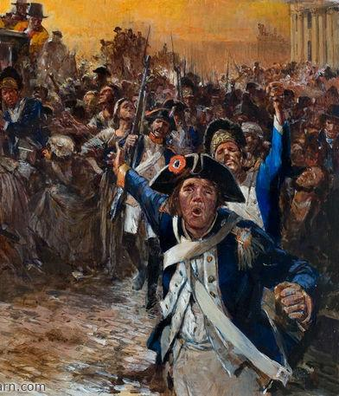
In 1792, radicals took control of France & made important decisions:
War was declared against Austria & Prussia and 300,000 French soldiers were drafted into a national army in order to defend France
The French monarchy was overthrown & democratic republic was created called the National Convention
In 1793, King Louis XVI was arrested, convicted of treason, & executed by guillotine
The slogan of the French Revolution became: “Liberty, Equality, Fraternity”

Slide 17
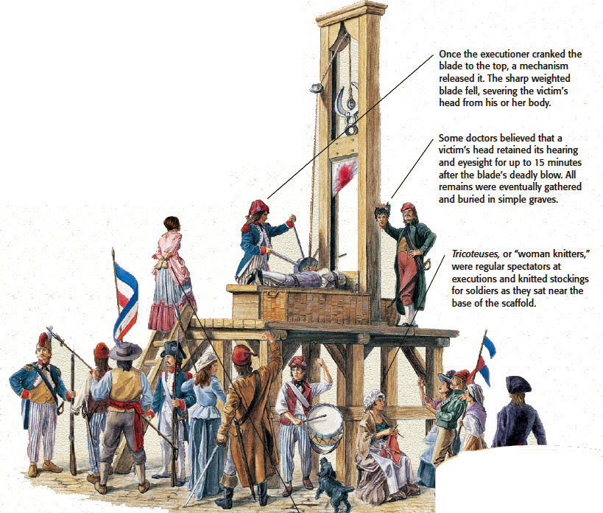
The Guillotine

Slide 18
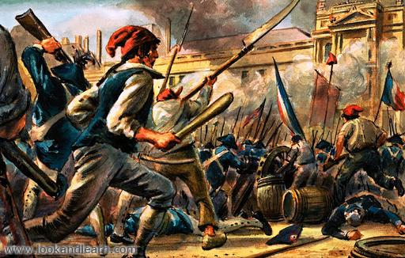
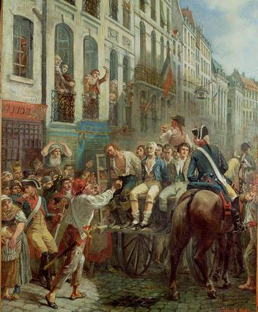
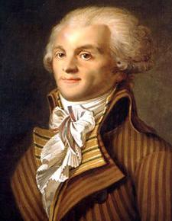
The radical leaders of the National Convention feared that “enemies of the revolution” would try to overthrow the new republic
In 1793, radical Maximilien Robespierre slowly gained control of the National Convention
From 1793 to 1794, Robespierre executed 40,000 “traitors” during an era known as the Reign of Terror
The Reign of Terror ended when French citizens turned on Robespierre & executed him

Slide 19
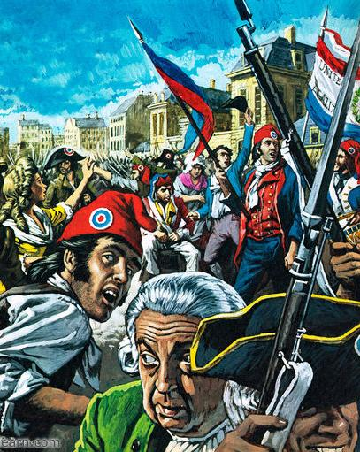
The revolution came to an end in 1795, but France was in chaos
The economic crisis had not been solved & people faced starvation
England, Holland, Spain joined Austria & Prussia in the war against France
The National Convention was replaced by France’s third gov’t in six years called the Directory
The Directory proved to be ineffective & corrupt

Slide 20
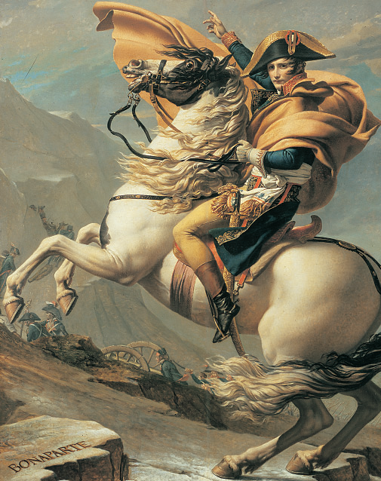
Napoleon Bonaparte
In 1799, a French military general named Napoleon Bonaparte led a coup d'état & seized power in France
As emperor of France, Napoleon introduced needed reforms, defeated foreign armies, & conquered a massive French empire

