Slide 1
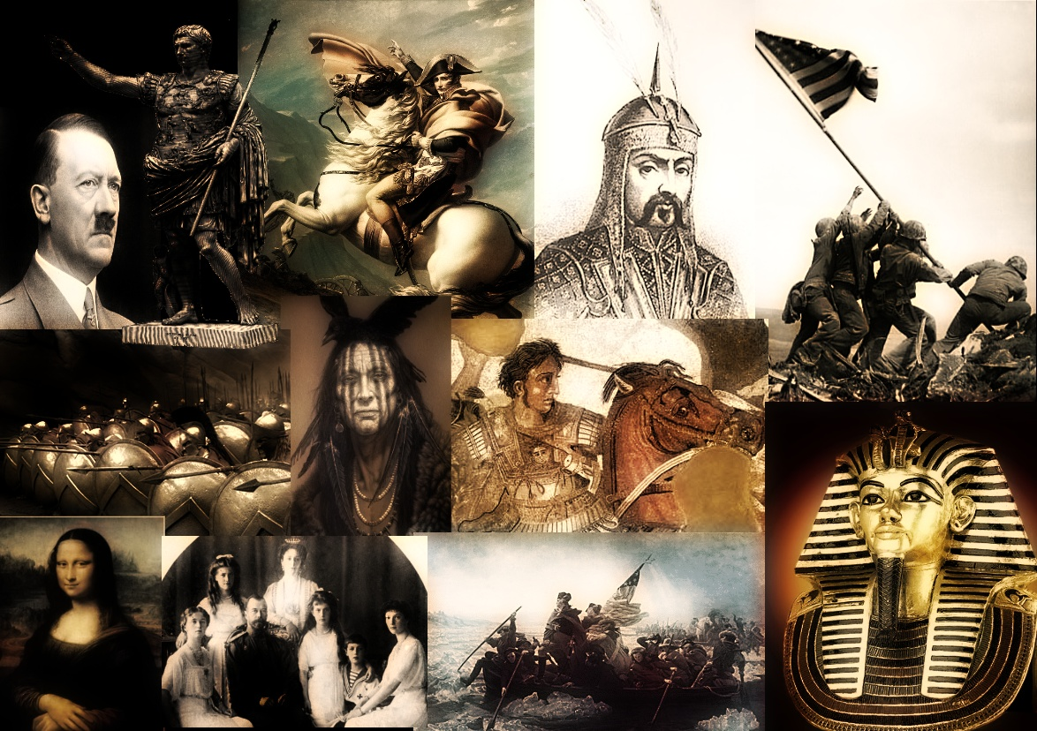
Welcome to Mr. Halkuff’s Classroom
Room 908

Slide 2
ABOUT ME
I’m 40 years old. (I know it’s hard to believe)
I’ve been married for 10 years and my wife works at Fuquay Varina High School as a science teacher.
I have two children, a 8 year old girl named Olivia, and a 5 year old boy named Jacob.
I’ve been a Social Studies teacher for 15 years, at both the middle and high school level.

Slide 3
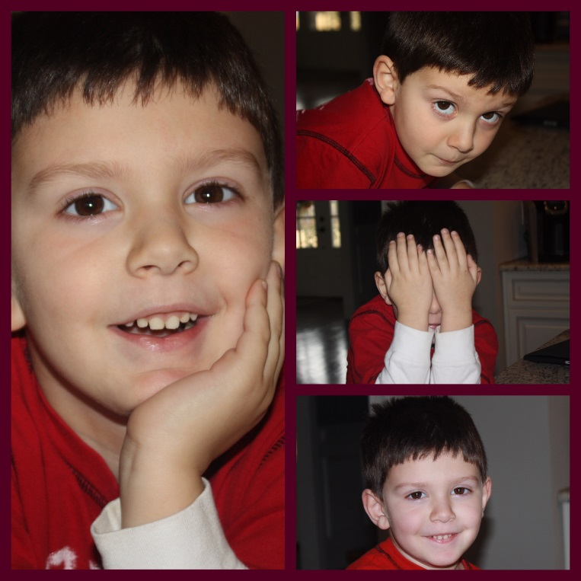
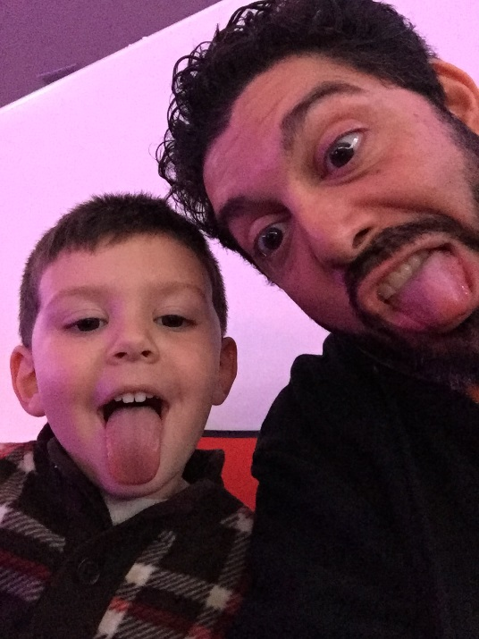
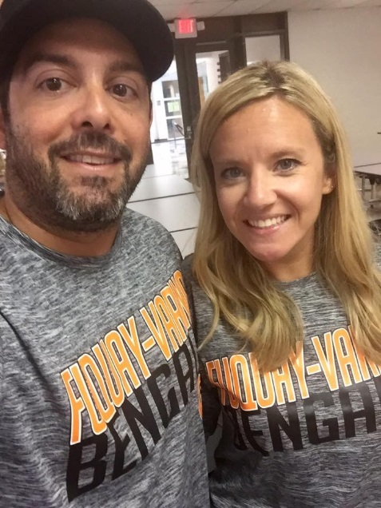
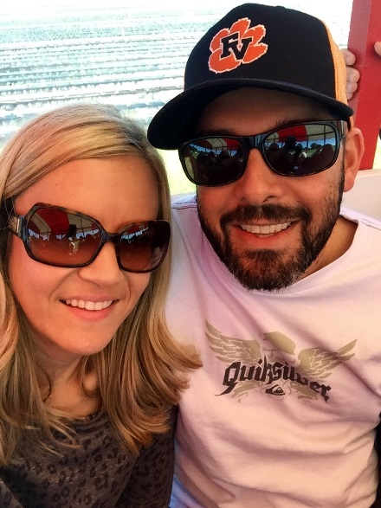
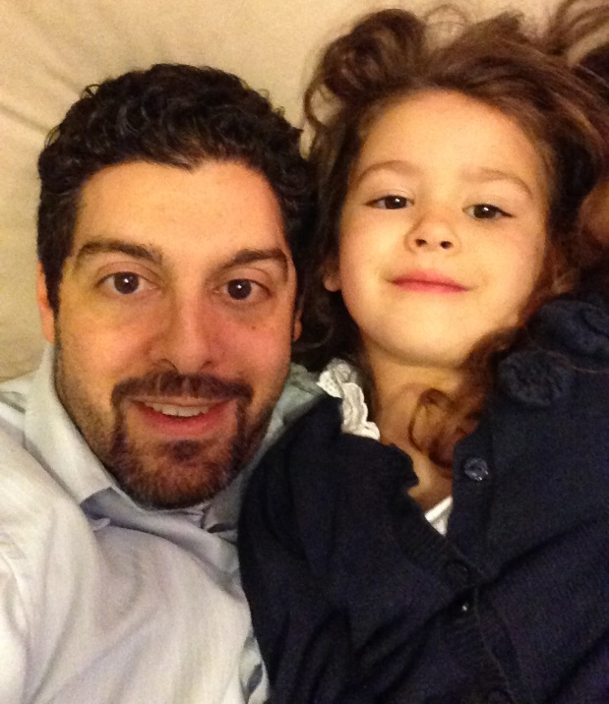
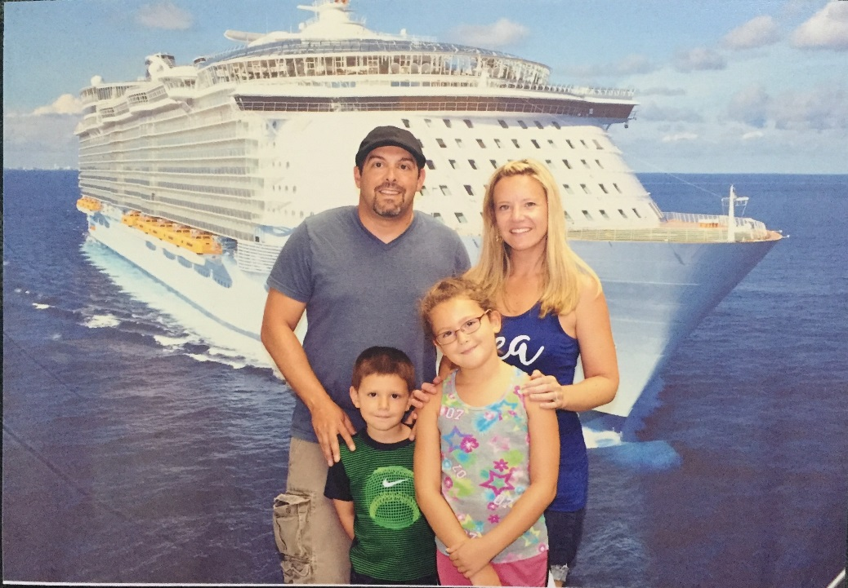
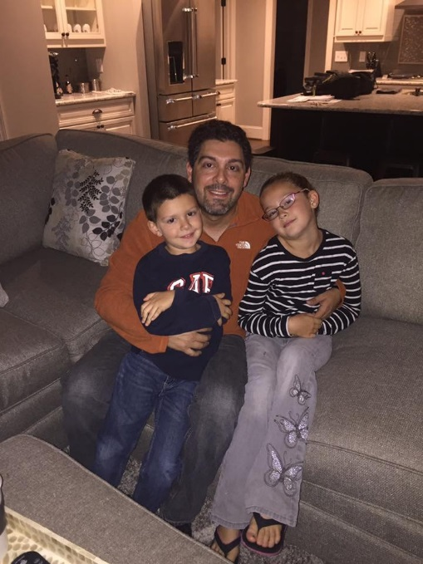
My family

Slide 4
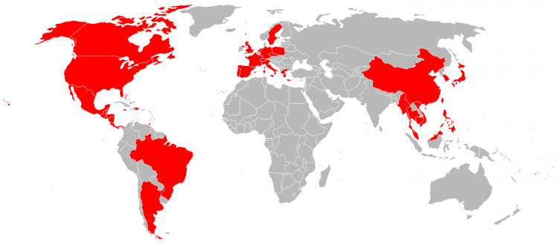
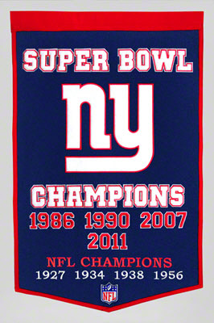
My Life
I was born in New York.
I grew up in Florida
I went to college at the University of Central Florida in Orlando, and ACE for my Master’s
I have lived in Miami, San Diego, Chicago, New York, Tampa, and Japan.
I have traveled all over the world.

Slide 5
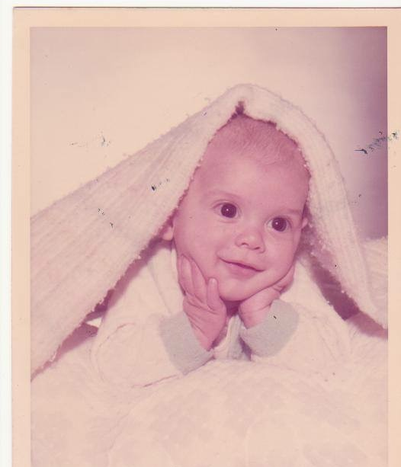
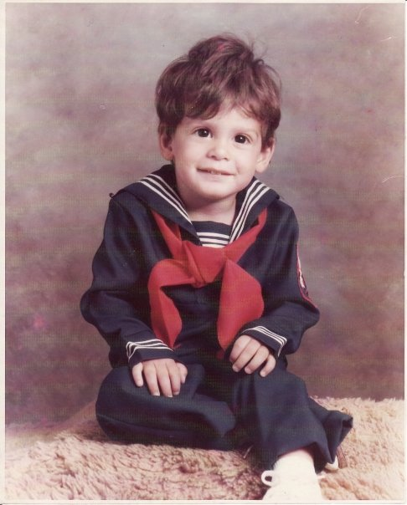
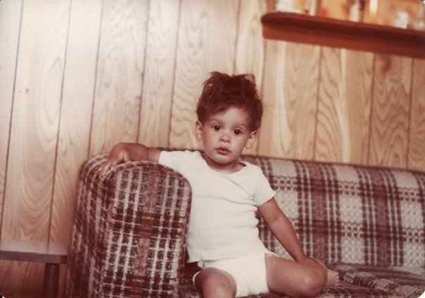
ABOUT ME

Slide 6
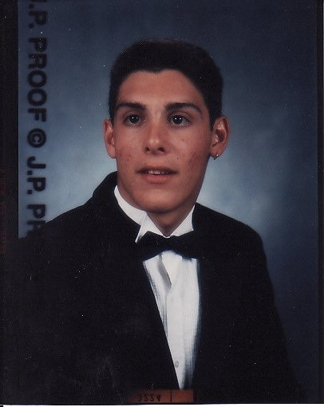
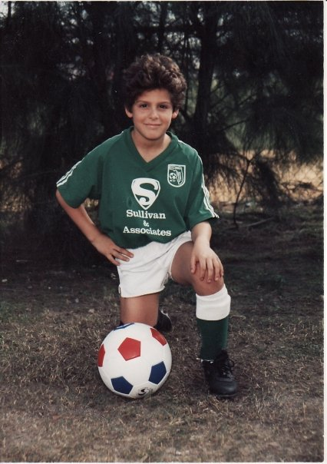
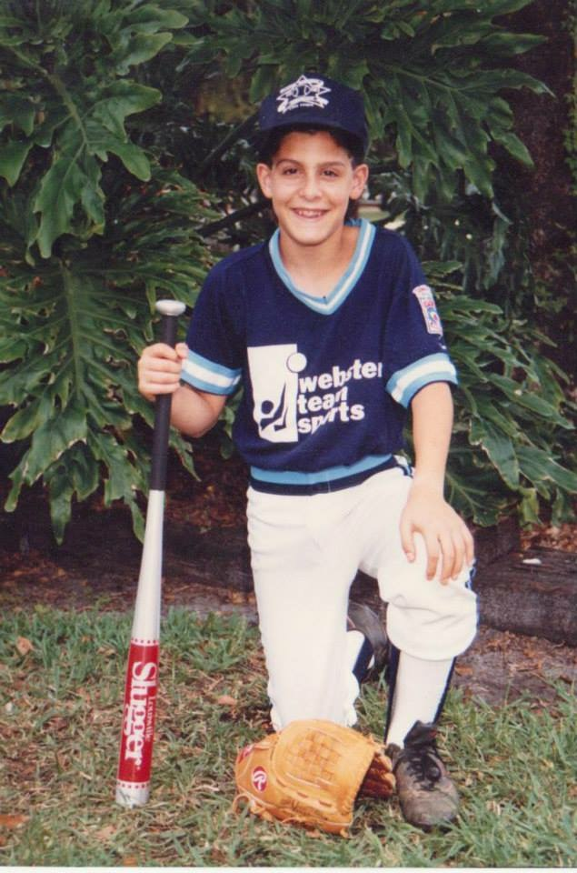
ABOUT ME

Slide 7
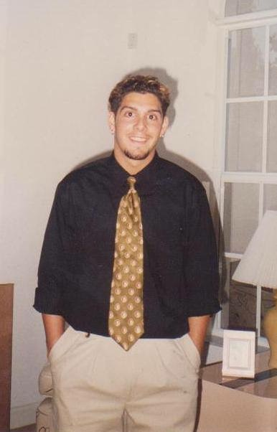
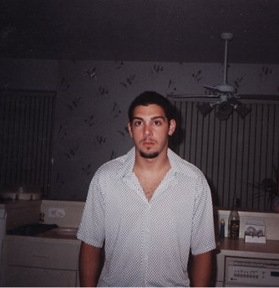
ABOUT ME

Slide 8
My Teaching style
I really like being a teacher.
I use humor, a lot.
I also sing and dance in class everyday.
I try to teach in a way that hits all the different learning styles.
I don’t yell and scream, and I won’t embarrass you in class.

Slide 9
My Teaching style
This is OUR CLASSROOM, but I’m in charge.
I want you to WANT to be here, and to feel comfortable.
I HATE bullies.
I will see the best in you, even if you don’t see it.

Slide 10
My Teaching Philosophy
“Where did we ever get the crazy idea that in order to make children do better, first we have to make them feel worse? Think of the last time you felt humiliated or treated unfairly. Did you feel like cooperating or doing better?”
Jane Nelson

Slide 11
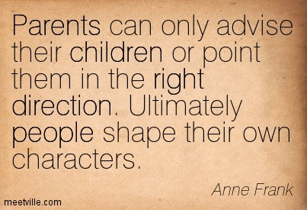
My Teaching Philosophy

Slide 12
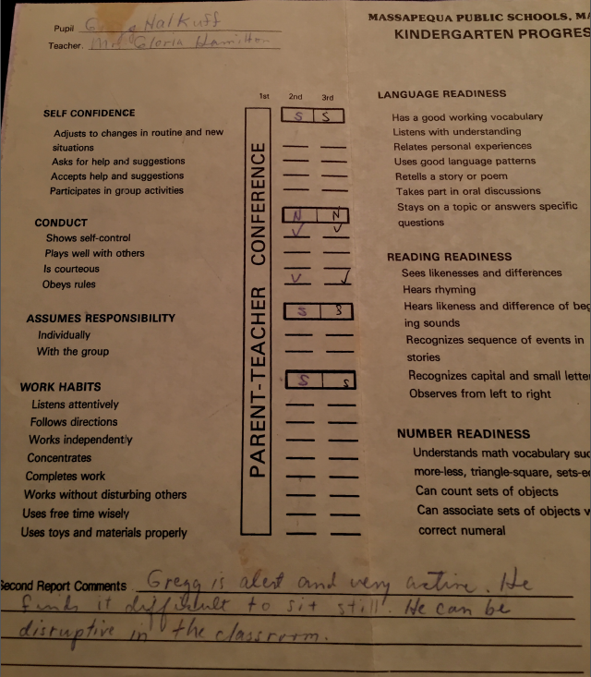
Young Mr. Halkuff

Slide 13
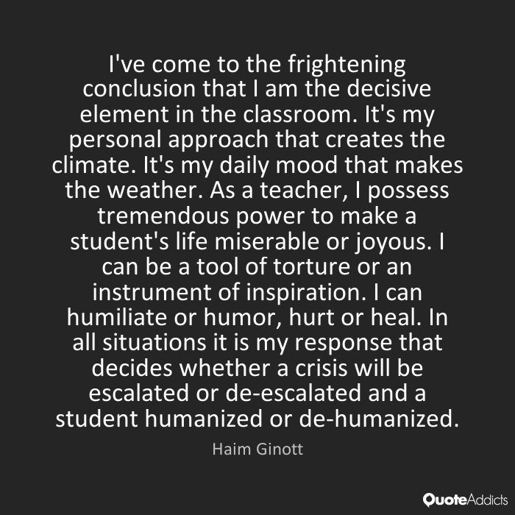
My Teaching Philosophy

Slide 14
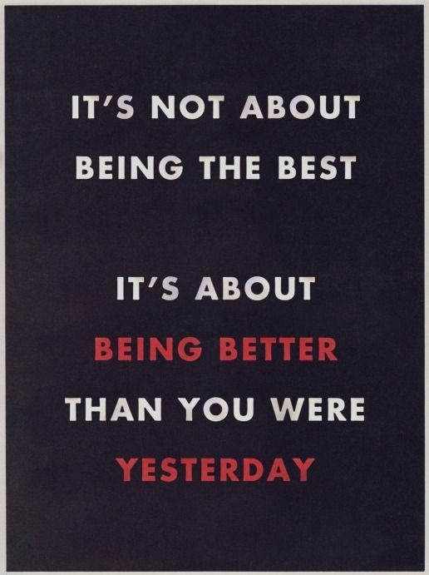
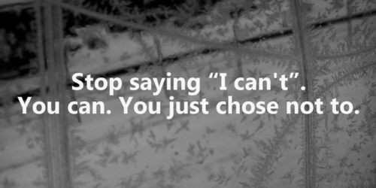
Growth Mindset

Slide 15
Your Job
Be On Time
Be Prepared
Be Respectful
Be Working
Don’t Be Afraid To Fail

Slide 16
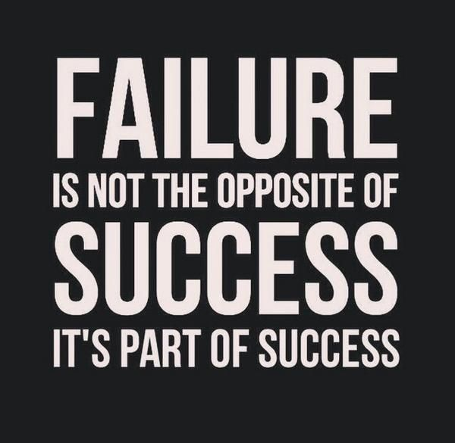
The Art of Failure

Slide 17
Your homework
Read Welcome Letter with parent or guardian
Fill out Student Info Sheet and BRING IT BACK TOMORROW
Get class supplies (if you cannot, talk to me privately, as I can help)
Show the spoken word poem to at least one person and get their reaction

Slide 18
