Slide 1
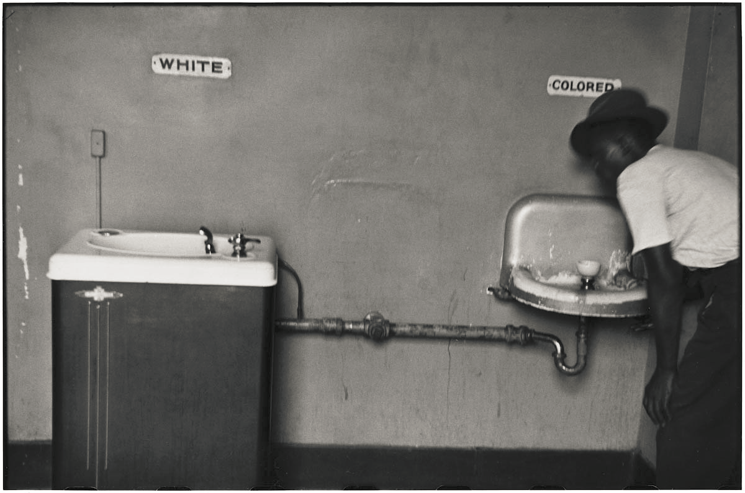
Journal Discussion
How did 300 years of American slavery affect the United States?

Slide 2
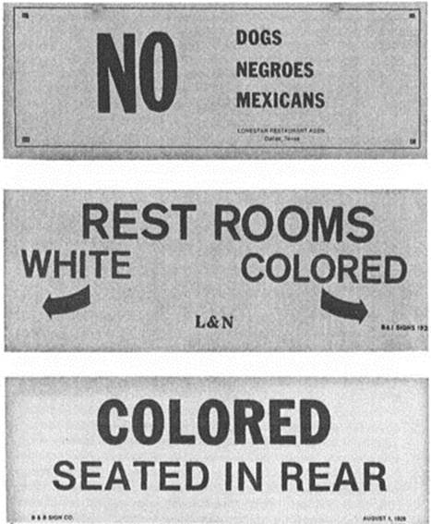
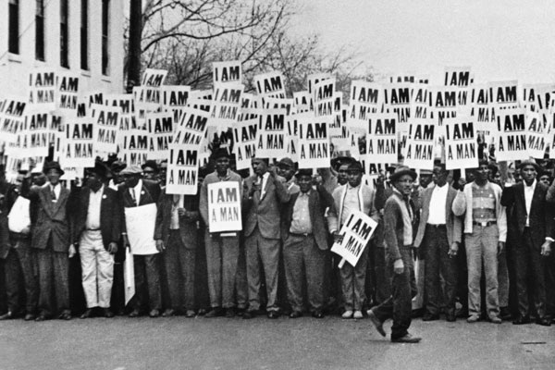
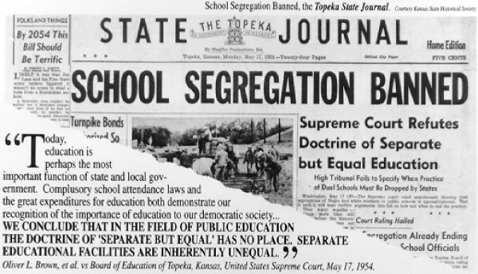

Slide 3
Colonies & Mercantilism
Gregg Halkuff
FVHS
World History

Slide 4
Spanish – Portuguese rivalry
The Portuguese thought that Spain was trying to claim land in India that Portugal already owned
Pope Alexander VI (Spanish-born) created the Treaty of Tordesillas that set the Line of Demarcation, which defined who had the rights to explore and claim which lands.

Slide 5
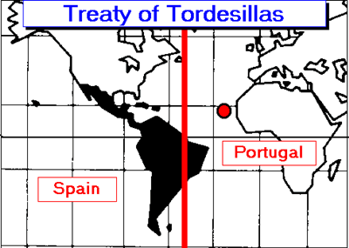
map

Slide 6
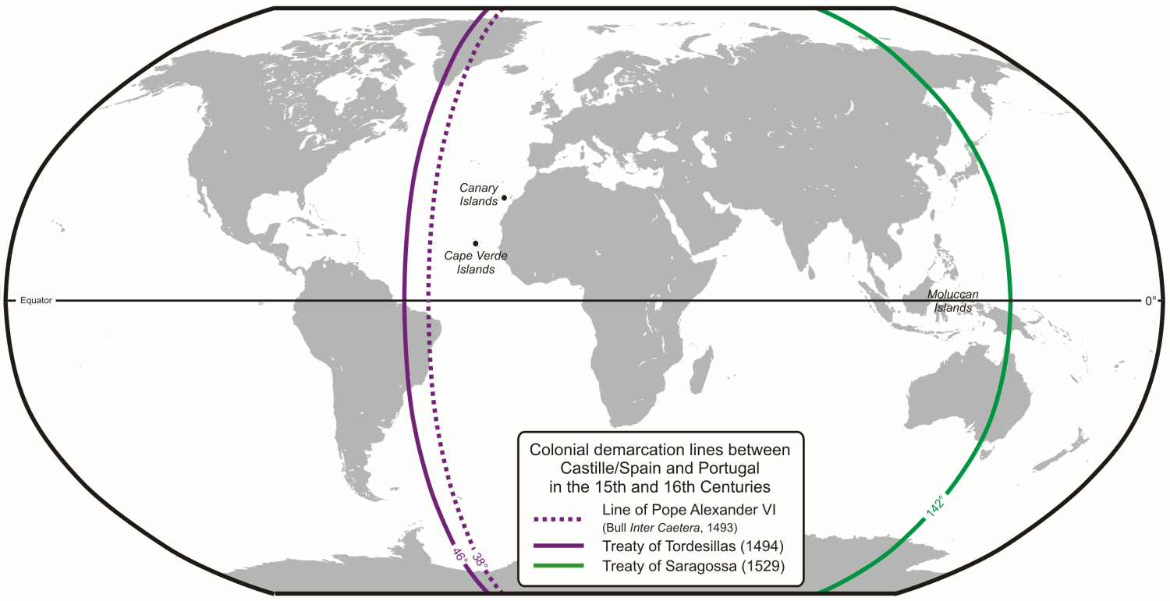
Line of Demarcation

Slide 7
Colonies
Colony: Settlement of people in a new territory linked with their parent country by trade and government control
Why did Europe choose to establish colonies?
How does something stop being a colony?

Slide 8
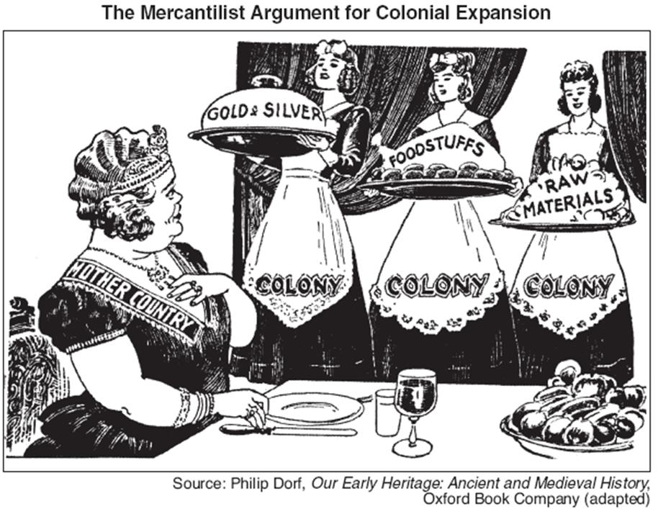

Slide 9
Mercantilism
The belief that a nation’s power depends on the amount of gold and silver it has
In order to collect more gold/silver, the country must export more goods than it imports
To limit the number of imports, a government can set up tariffs, taxes on imported goods.

Slide 10
Triangular Trade
Trade route that connected Europe, Africa, and the Americas
Ships brought manufactured goods like guns and cloth from Europe to Africa
Merchants traded goods for slaves, and brought the slaves to the Americas (The Middle Passage)
Slaves were sold in the Americas in exchange for raw materials like sugar and cotton

Slide 11
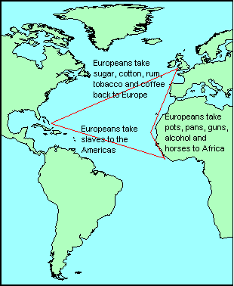
Triangular Trade

