Slide 1
Classical Greece & The Hellenistic Era

Slide 2
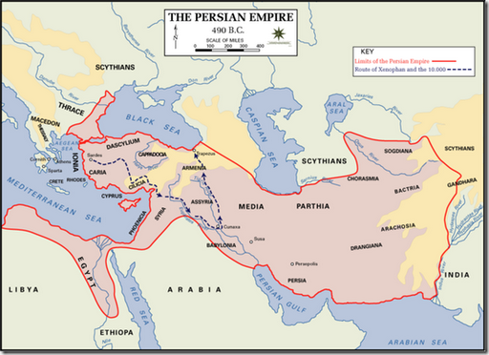
Persian Empire: East of Greece

Slide 3
The Persian Wars
The Persian Empire, to the east of Greece, became a threatening presence.
After Athens led an unsuccessful revolt against Persia, Persian leader Darius sought revenge.
First Persian War
Heavily outnumbered Athenians defeat the Persians at Battle of Marathon
Second Persian War
300 Spartans held off 200,000 Persians for 2 days, giving Athens time to mobilize its navy and defeat Persia at Salamis

Slide 4
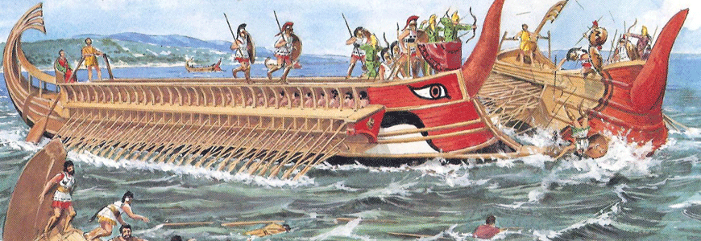
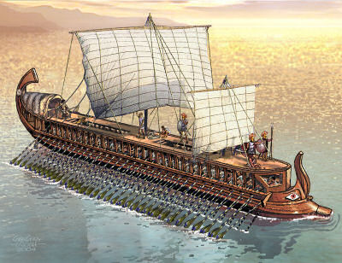
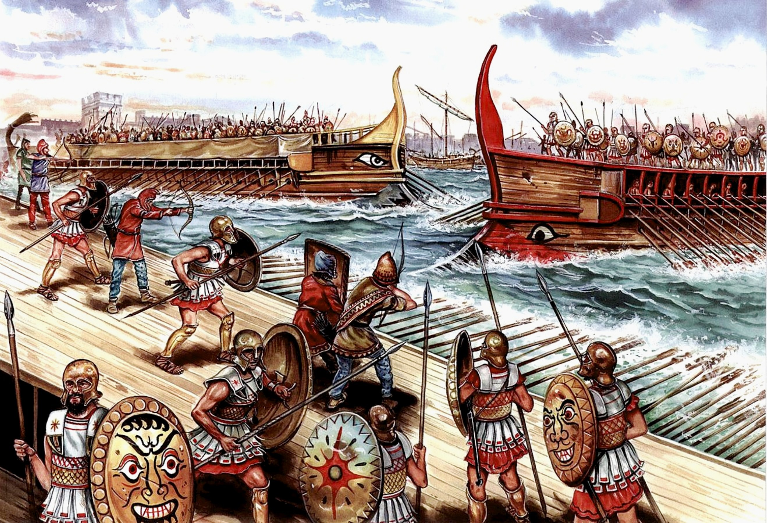
Athenian Navy ship

Slide 5
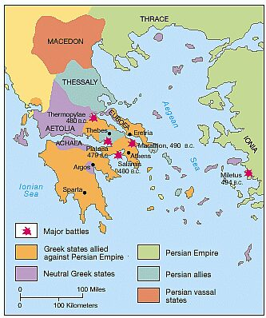
Battle of Marathon, Salamis

Slide 6
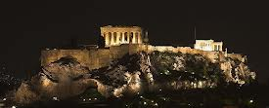
The Golden Age of Athens
After the Persian War, Athens forms the Delian League to prevent further invasion.
Under Pericles, Athens began a system of direct democracy, in which citizens participate directly in government decision making.

Slide 7
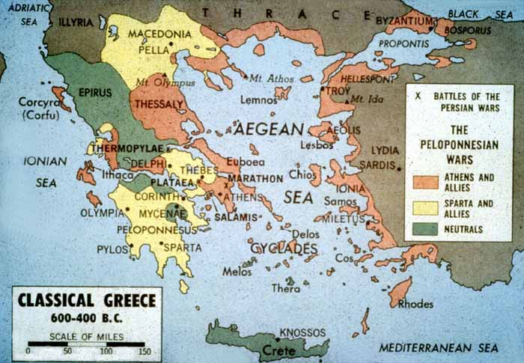
Peloponnesian War
Sparta and its supporters felt the Delian League was growing too strong.
A series of disputes led to the great outbreak of the Peloponnesian War
Athens remains behind city walls while Spartans surrounded them.
Heavy combat losses & a plague led to Athens’ defeat.

Slide 8
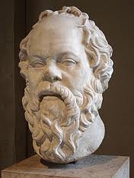
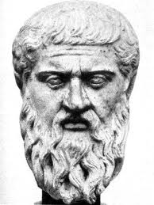
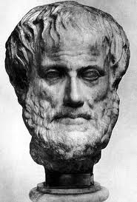
Socrates, Plato, & Aristotle

Slide 9
Culture of Greece
Greek religion revolved around a family of Greek gods and goddesses, including Zeus, the father of the gods.
Philosophers focused on critical thought and explaining the universe
Socrates encouraged questioning and taught students using his Socratic method. He was sentenced to death for corrupting youth.

Slide 10
Culture of Greece
Plato – Student of Socrates, wrote The Republic, encouraging citizens to perform their role in society
Aristotle – Student of Plato, promoted moderation, the midpoint between reckless behavior and cowardice, as the correct way to live. “The Golden Mean”

Slide 11
Alexander the Great
From Macedonia, a region north of Greece
Athens & others fought Macedonian leadership, but were eventually taken over
He was 20 when he became King, and wanted to fulfill his father’s dream of invading Persia
Conquered Persian Empire in 331 and continued expanding towards today’s Pakistan & India
His legacy created the Hellenistic Era, a goal of combining Greek and Persian languages and cultures.

Slide 12
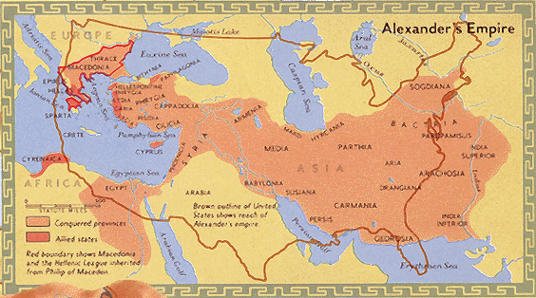
Alexander’s Empire

Slide 13
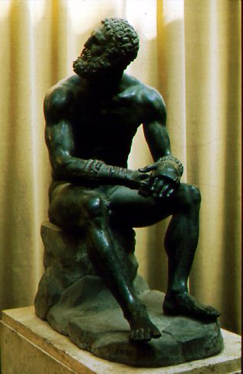
Hellenistic Culture
Alexander the Great intended for all of his conquests’ cultures to blend. Monarchs after his death only allowed Greeks and Macedonians to rule, so Persian culture was not widespread.
This culture valued achievements in art, science, and philosophy.

