Slide 1
The Medieval Church

Slide 2
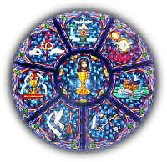
Medieval Christianity
Christianity became the primary religion in Western Europe.
Local priests administered the sacraments, sacred rites of the Christian Church.
Christians believed that participating in the sacraments would lead them to eternal life.
Christian Sacraments: Baptism, Confirmation, Eucharist (communion), Absolution (confession), Marriage, Holy Orders, Anointing of the Sick

Slide 3
Monasteries and Convents
Monks and Nuns decided to remove themselves from worldly life to devote their lives entirely to spiritual goals.
Provided basic health and educational services in the villages.
Women in the convents were not limited like they were in society. (One composed music & wrote books in the convent)
Monastery in Belmont, NC: Belmont Abbey Benedictine Monastery

Slide 4
Religious Authority v. Political Power
The Church held absolute power in religious matters because they were in control of who received the sacraments, an important step in receiving eternal life.
Canon Law – Church law based on religious teachings.
Those who disobeyed Canon law could be excommunicated – could not receive sacraments or a Christian burial after death. An entire city could be excommunicated if their Noble faced the interdict.
The Church was heavily influenced by Nobles, and Pope Gregory VII declared that religious leaders could not receive power from anyone outside of the Church.

Slide 5
Culture: Commercial Revolution
Trade increased, causing the demand for silver & gold coins to rise
A money economy emerged… (An economic system using money rather than bartering)
Commercial Capitalism – People invest in order to make profits
Guilds were associations to protect artisans’ business. No one except guild members could work in any trade.
Apprentice – trainee (age 7-8)
Journeyman – salaried worker, until he can afford to open his own shop.

Slide 6
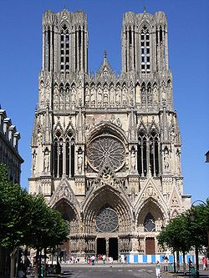
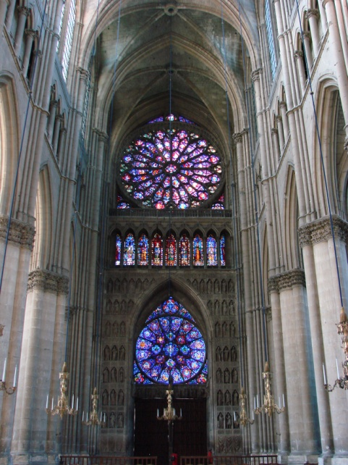
Architecture in the Church
Cathedrals were built in the Gothic Style – vaulted ceilings & rectangular shapes.

Slide 7
Holy Roman Empire
Ch. 8 Section 1

Slide 8
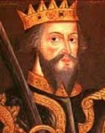
Europe in the Late Middle Ages
During the Early Middle Ages, nobles & monarchs had equally as much power as the popes.
Monarchs organized government systems, started taxing people, and set up armies. The townspeople liked this b/c it would keep everyone peaceful & allow trade to flourish

Slide 9
English Kings
Various groups settled England – Vikings, Angles, Saxons
William of Normandy, with the support of the Pope, led troops at the Battle of Hastings.
He is crowned the King of England on Dec. 25, 1066.
He granted fiefs to the Church & took a complete census of the country. Every castle, field, and pigpen was recorded in his Domesday Book.
Henry II ruled from 1154 – 1189.
He expanded the power of the royal courts by turning ordinary customs into law = “Common Law”
He sent judges to enforce the law in all of England.
Clashes with heads of the Church over power

Slide 10
The Magna Carta
King John was hated by the King of France, the Pope, and his own English nobles. (The Pope excommunicated him… :/ )
After abusing his power, his own nobles forced him to sign the Magna Carta, a document of rights.
Acknowledged that nobles had rights (eventually all citizens would be included
Declared that the Monarch must obey the law
Parliament: Representative government in England
Set taxes (“Power of the Purse”), discussed politics, passed laws.

Slide 11
French Monarchs
After Charlemagne, a lot of small French villages were ruled by powerful nobles.
During King Philip IV’s rule, the French Estates General (parliament) is created.
First Estate: Clergy
Second Estate: Nobles
Third Estate: Townspeople
The Estates General never gained the Power of the Purse or could hold French kings accountable like England’s Parliament.

Slide 12
Holy Roman Empire
Ruled by Germans, created by Otto I, King of Germany
Popes & Emperors fought over power:
King Henry IV v. Pope Gregory VII
Pope Gregory VII excommunicated King Henry, he confessed, the Pope forgave him.
Compromise = Condordat of Worms: Only the Church had power to appoint bishops.
King Frederick II went to Italy to convince popes to join the Holy Roman Empire. He was unsuccessful & the Holy Roman Empire dissolved into many independent states.

