Slide 1
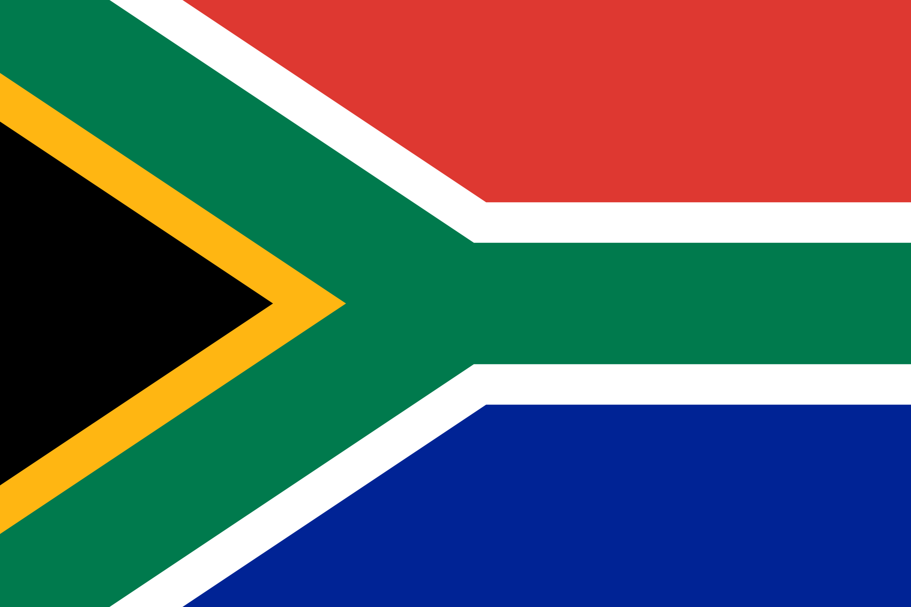
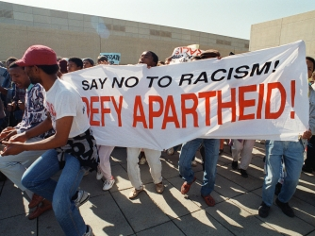
South Africa & Apartheid

Slide 2
Africa after WWII
After WWII, when European countries were forced to withdraw from India & Vietnam, African colonies increasingly demanded their own independence. By the 1960s, most had achieved independence
Some new African nations enjoyed peace and democracy, but others faced military rule by harsh dictators.

Slide 3
South Africa’s Independence
South Africa was colonized by the British and in 1910 the white colonists declared independence for the nation.
Whites continued to dominate the political system by not allowing the black majority to vote and requiring all citizens to register by race: black, white, colored, Asian. This legal segregation is known as apartheid.

Slide 4
South Africa’s Independence
The African National Congress (ANC) was the leading anti-apartheid organization that led the struggle for democracy.
Marches, boycotts and strikes were violently interrupted by the government police.
Nelson Mandela led the ANC in armed resistance and was sentenced to life in prison until 1990.

Slide 5
End of Apartheid
Some countries imposed economic sanctions on South Africa in the 1980s to encourage the end of apartheid.
Why would economic sanctions affect South Africa’s government?
Upon his release from prison, Mandela became the first democratically elected President of South Africa, and South Africa’s first black President.
Nobel Peace Prize winner Bishop Desmond Tutu worked to free Nelson Mandela and others.

Slide 6
Challenges outside South Africa
Some African leaders believed in the dream of Pan-Africanism, or the unity of all black Africans, regardless of nationality.
Why was unity difficult to achieve within African nations?
Many African nations faced civil war between ethnic groups. In Rwanda, conflict occurred between Hutu and Tutsi peoples. As many as 3 million people died as a result of mass genocide.
Notes:
Why was unity difficult to achieve within African nations? European powers had drawn country lines arbitrarily, not considering the different ethnic, linguistic, and territorial groups.

